Slide 1
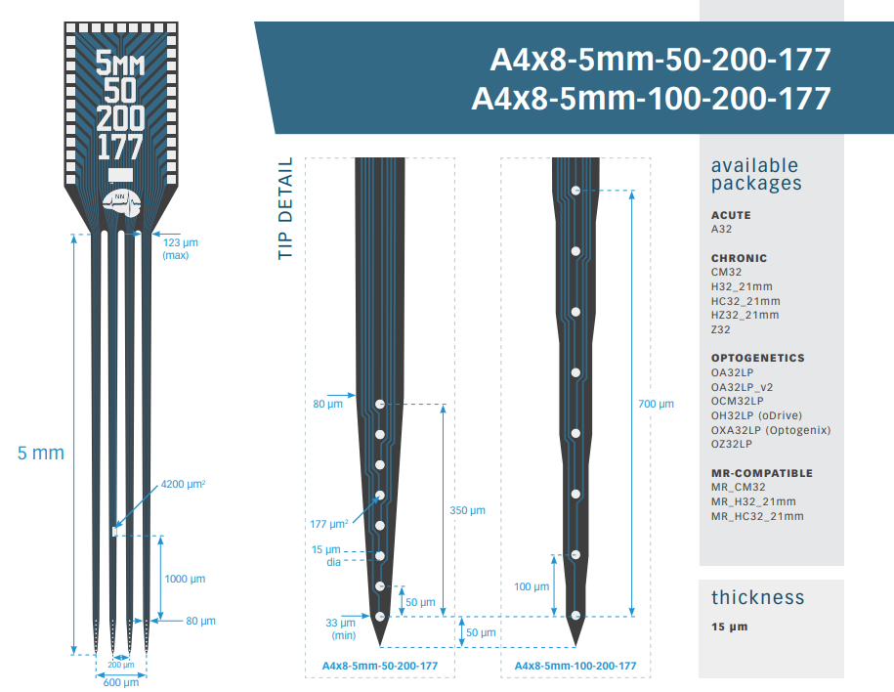
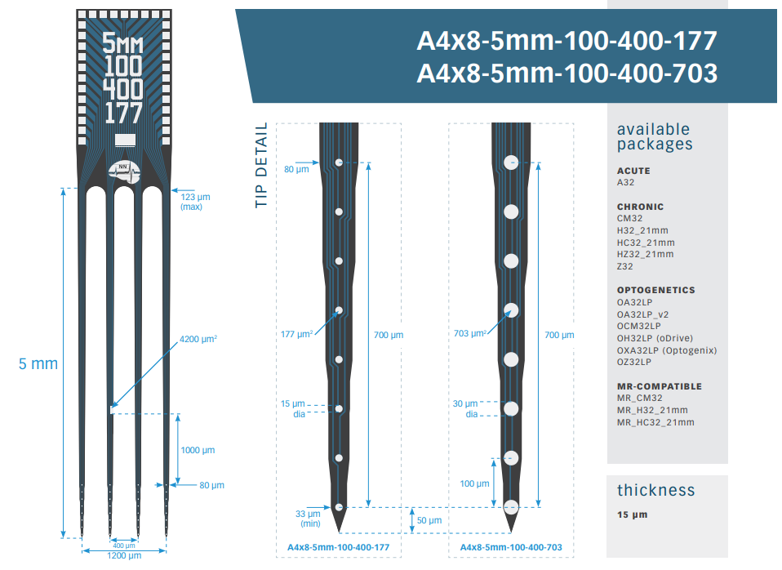
Probe a & b
Probe c & d

Slide 2
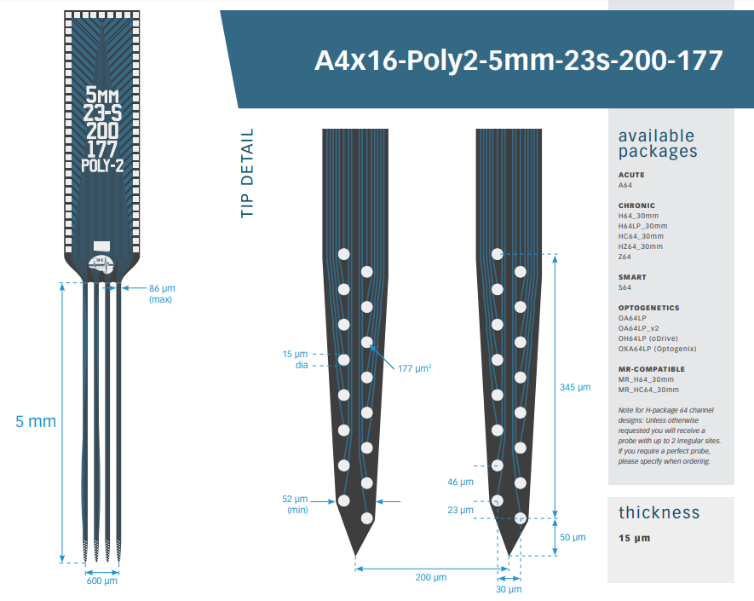
Probe e

Slide 3
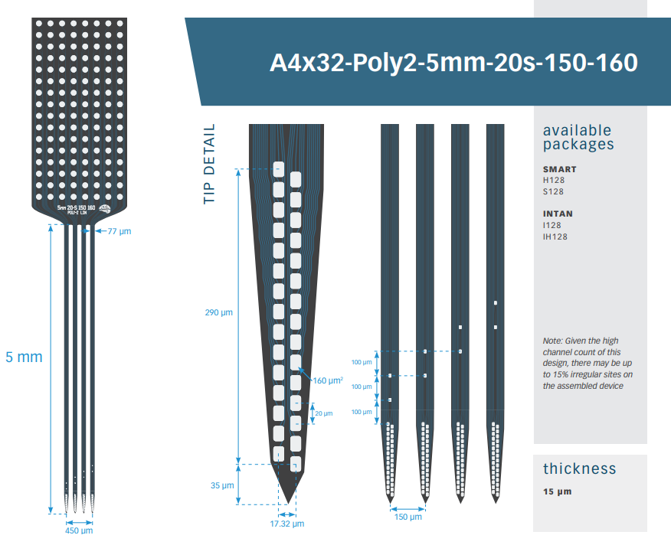
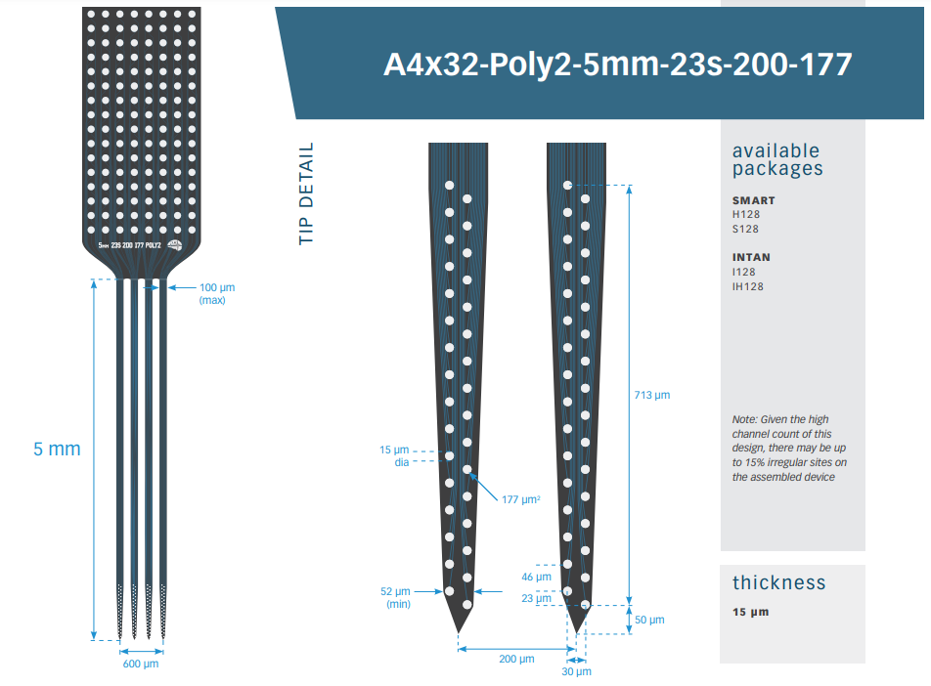
Probe f
Probe g

Slide 4
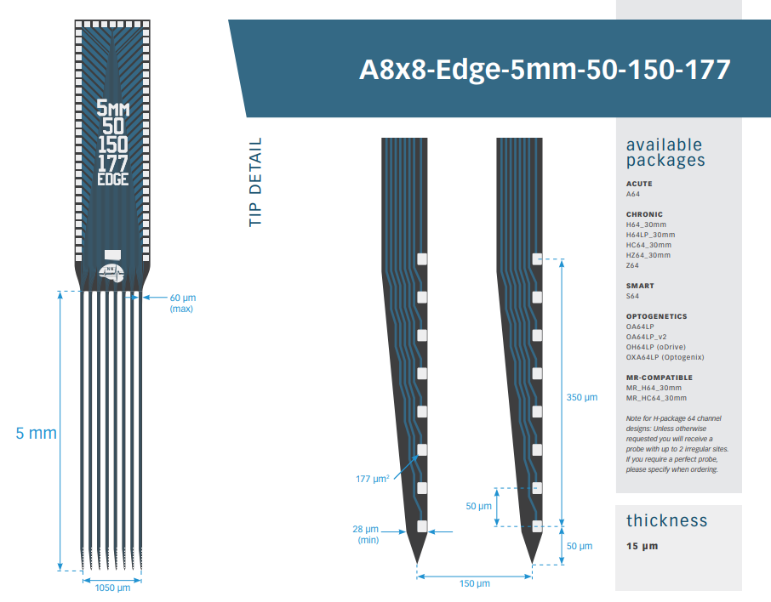
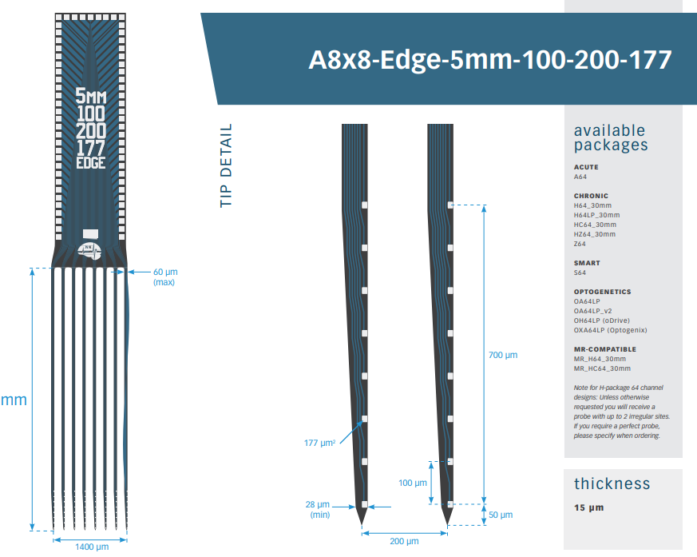
Probe h
Probe i

Slide 5
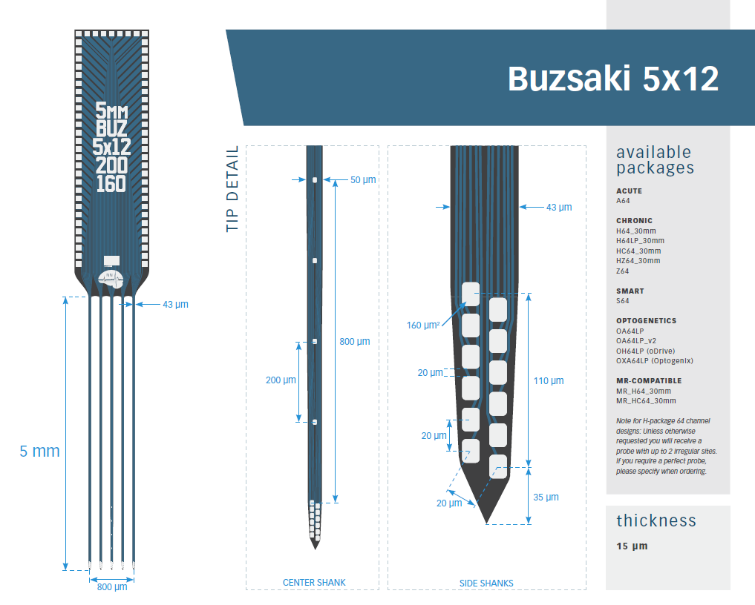
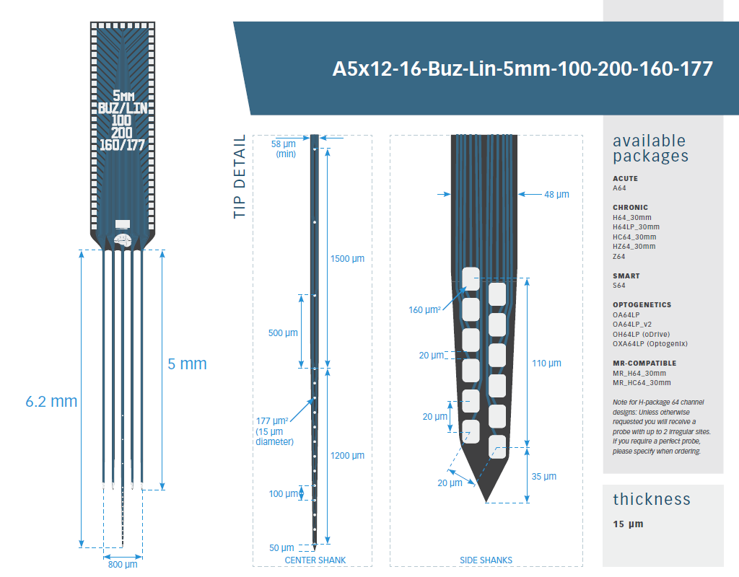
Probe j
Probe k

Slide 6
Please list your level of interest from 0-10 (0 – Hate it , 10 – Love it! ) for each configuration and then arrange an order/rank of preference from 1 to 12 (1 first to 12 last, each probe takes one rank)
Interest level | Preference order/rank | Index | Probe configuration | Site spacing (um) | Site range (um)
0 | 12 | a | A4x8-5mm-50-200-177 | 50 | 350
0 | 12 | b | A4x8-5mm-100-200-177 | 100 | 700
0 | 12 | c | A4x8-5mm-100-400-177 | 100 | 700
0 | 12 | d | A4x8-5mm-100-400-703 | 100 | 700
8 | 2 | e | A4x16-Poly2-5mm-23s-200-177 | 46 | 345
0 | 12 | f | A4x32-Poly2-5mm-20s-150-160 | 20 | 290
0 | 12 | g | A4x32-Poly2-5mm-23s-200-177 | 46 | 713
0 | 12 | h | A8x8-Edge-5mm-50-150-177 | 50 | 350
0 | 12 | i | A8x8-Edge-5mm-100-200-177 | 100 | 700
9 | 3 | J | Buzsaki 5x12 | 20 | 110
10 | 1 | K | A5x12-16-Buz_Lin | 20 | 110

