Slide 1
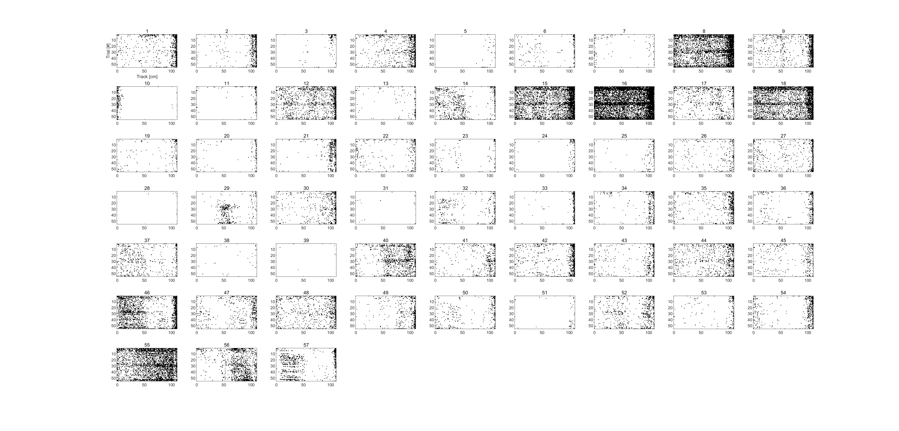
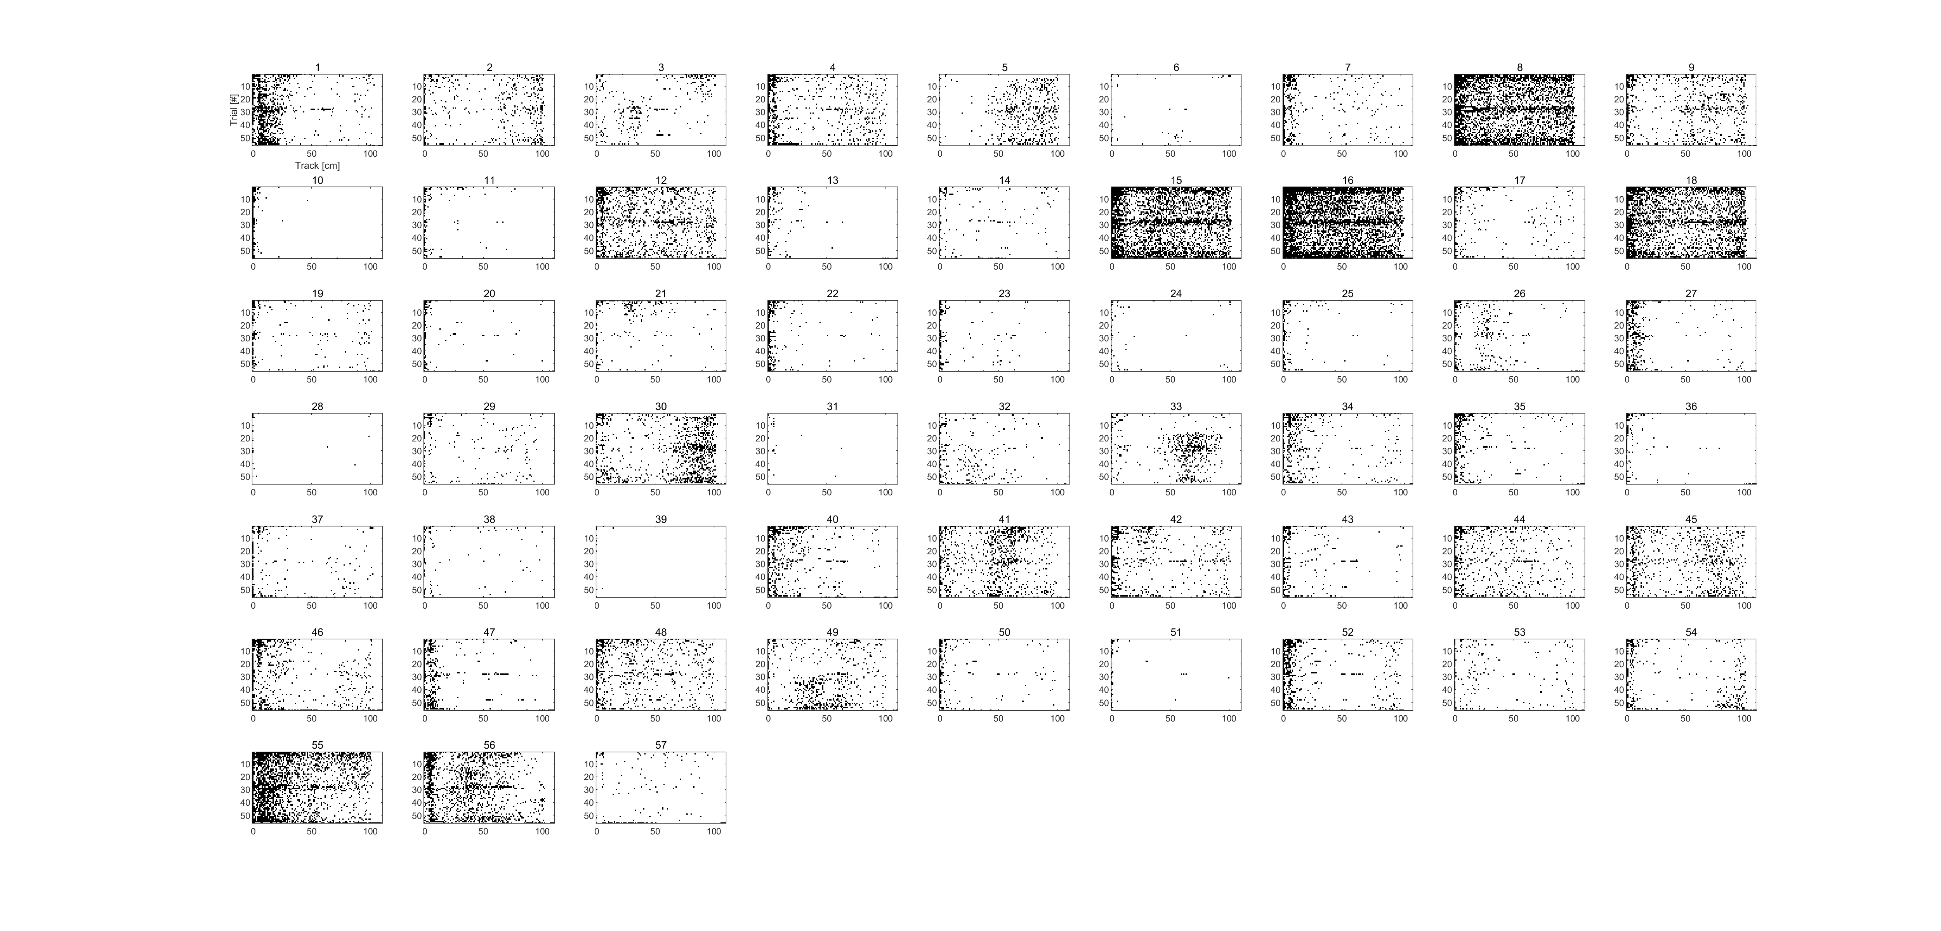
SPONTANEOUS FORWARD
SPONTANEOUS REVERSE

Slide 2
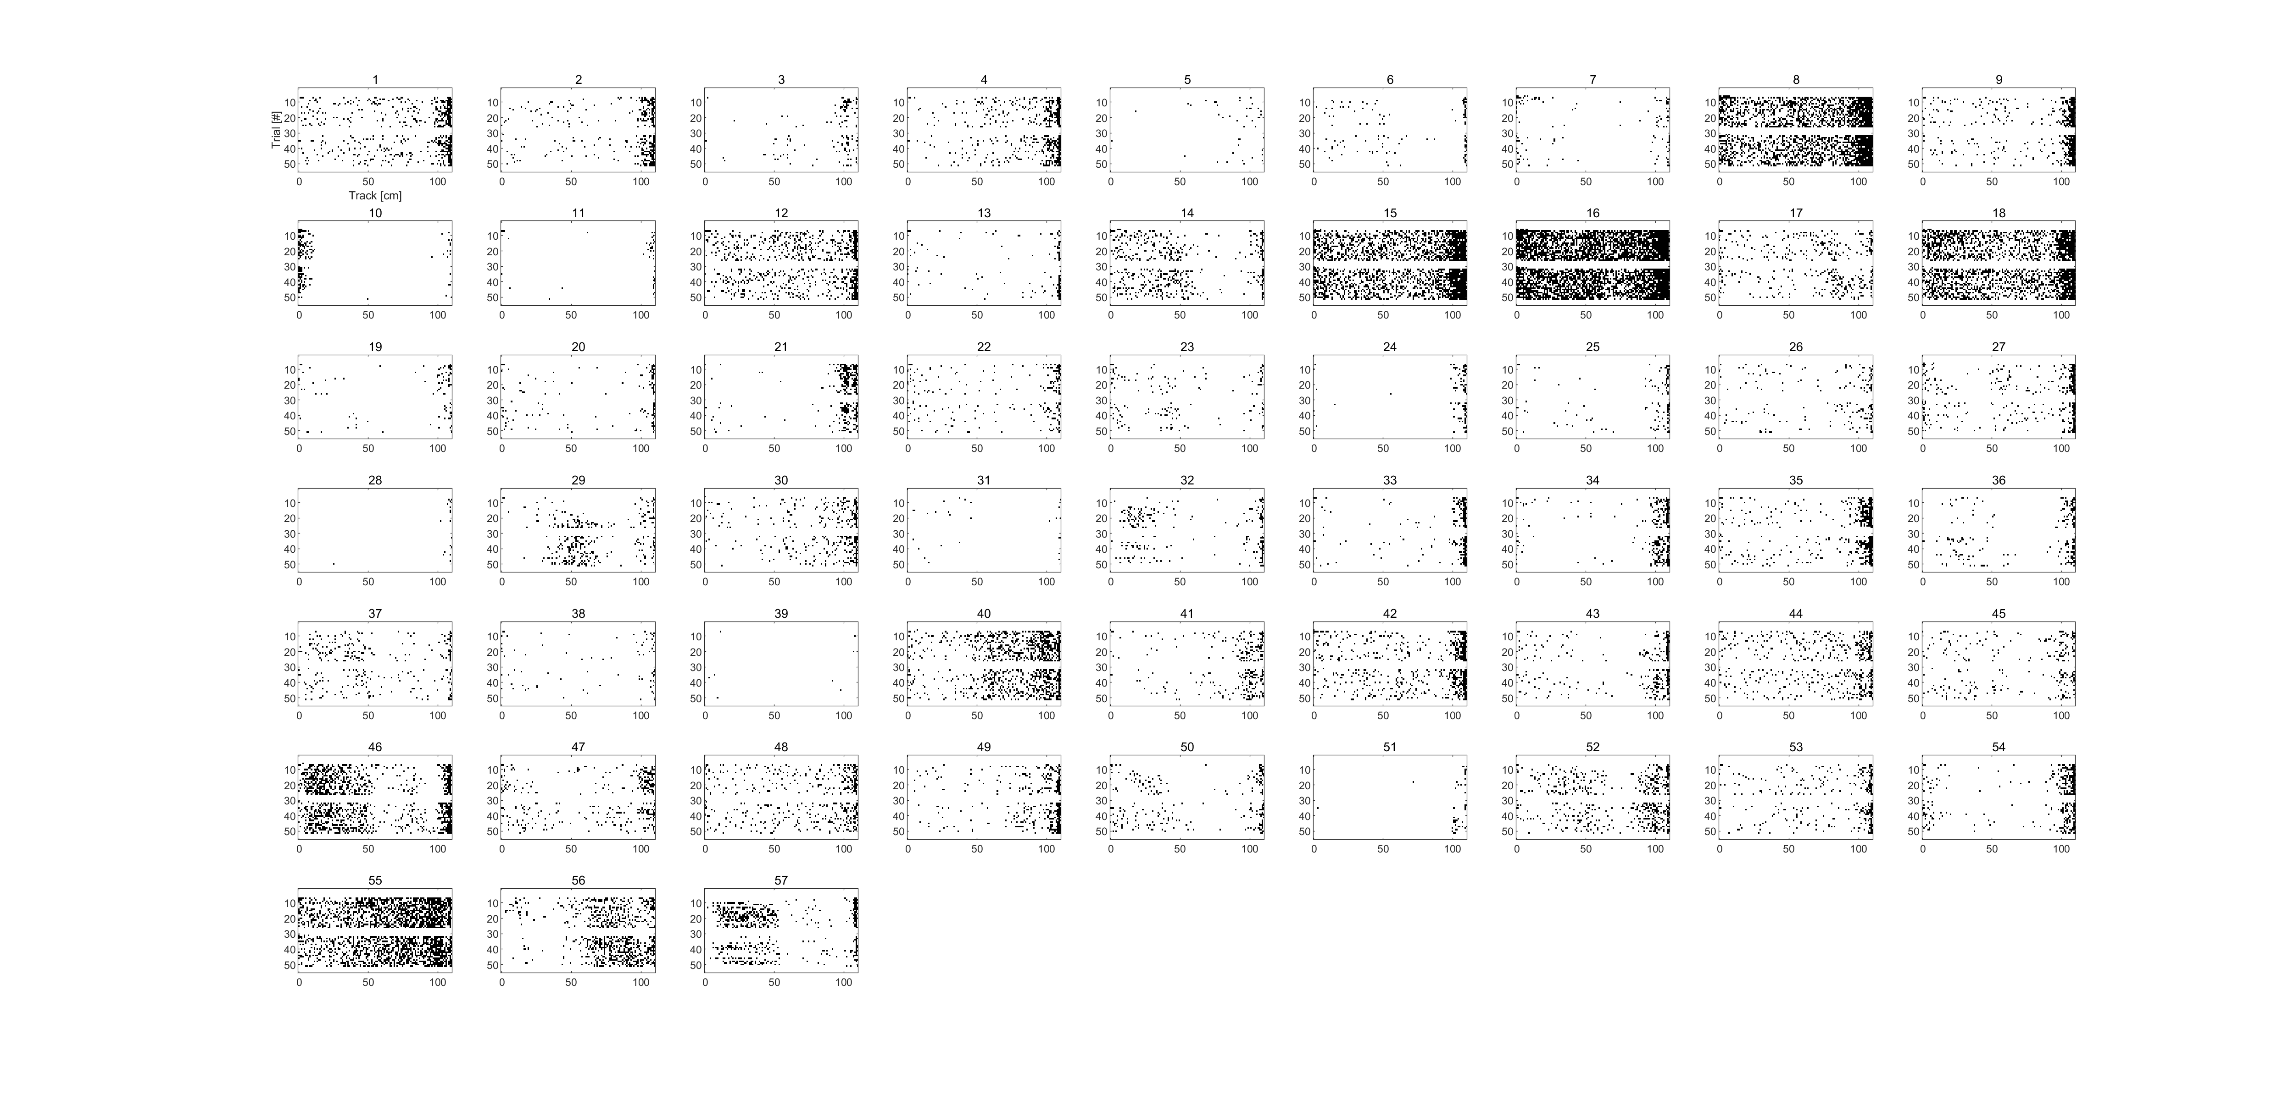
STIMULATED FORWARD
STIMULATED REVERSE

Slide 3
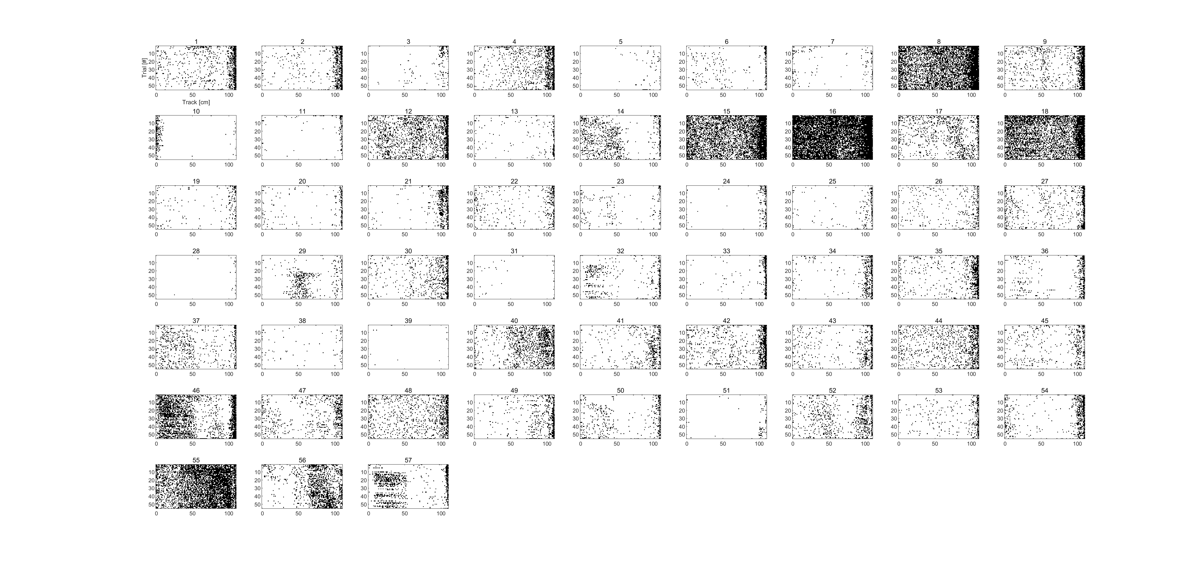
SUBSAMPLED FORWARD
SUBSAMPLED REVERSE

Slide 4
FULL FORWARD
FULL REVERSE

